Slide 1



HR Analytics Dashboard: Power BI Project With python
This Power BI project provides insightful visualizations and analysis of HR data, empowering HR professionals to make data-driven decisions and improve employee engagement.

Slide 2


About the Project
The HR Analytics Dashboard offers a comprehensive overview of key HR metrics and trends.
1
Employee Count
2
Attrition Trends
Provides a snapshot of the total number of employees.
Shows the number and rate of employees leaving the company.
3
Demographics
4
Job Satisfaction
Provides insights into employee age, gender, and education.
Reveals employee satisfaction levels across different roles.

Slide 3



Technologies Used
The project utilizes Power BI and Excel to create interactive and insightful visualizations.
Power BI
Excel
A powerful business intelligence tool for data visualization and analysis.
A spreadsheet software used for data manipulation and preparation.
Python
Data prediction

Slide 4
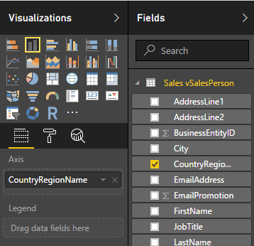
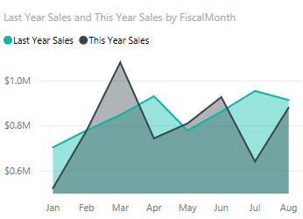
Power BI Building Blocks
Visualizations
Datasets
Reports
Dashboards
Tiles
Notes:
Power BI is a set of services and tools that serve as building blocks for creating powerful Business Intelligence experiences. The primary elements of the Power BI design experience are Visualizations, Datasets (or connections to data stores and services), Reports, Dashboards, and Tiles. The elements are combined into an experience that gets published and shared to users in your organization.

Slide 5
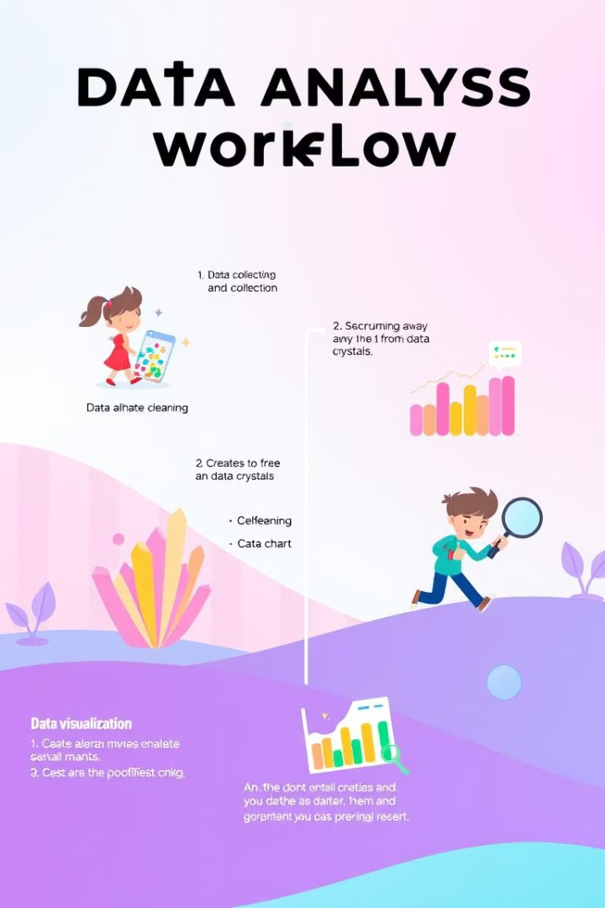
Steps Overview
The project follows a structured approach to data analysis and visualization.
1
Data Collection
Gathering HR data from various sources.
2
Data Cleaning
Identifying and addressing data inconsistencies and errors.
3
Data Visualization
Creating interactive charts and graphs to represent data insights.

Slide 6
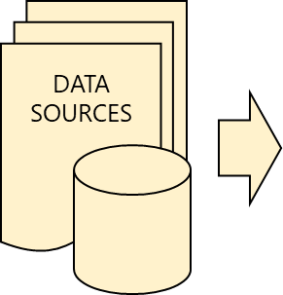

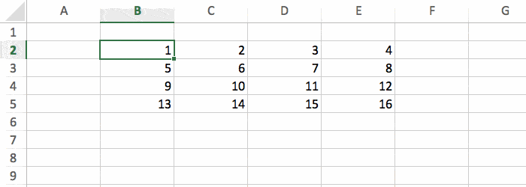
HR Dataset Overview
Summary of HR and Engagement Survey Data
The HRIS sheet contains 26 columns focusing on employee demographics, roles, and job-related metrics.
Key Information:
- Employee Demographics: Name, Office, Age, Gender, Marital Status
- Job Metrics: Attrition, Business Travel, Department, Job Role, Job Level, Monthly Income, Years At Company, maps coordinate X&Y
Engagement Survey Sheet Overview
The Engagement Survey sheet measures employee satisfaction and engagement.
Key Information:
- Satisfaction Metrics: Relationship Satisfaction, Job Satisfaction, Environment Satisfaction
- Work Metrics: Training Times Last Year, Work Life Balance, Job Involvement

Slide 7

Dashboard Content
The dashboard provides a comprehensive view of HR data, with various sheets dedicated to specific areas of analysis.
KPI Sheet
Department-wise Attrition
Displays key performance indicators like employee count, attrition rate, and average age.
Shows the distribution of attrition across different departments.
key influencers
The Key Influencers visualization in Microsoft Power BI is a machine learning tool that helps users identify the factors that most impact a metric or condition in their data

Slide 8
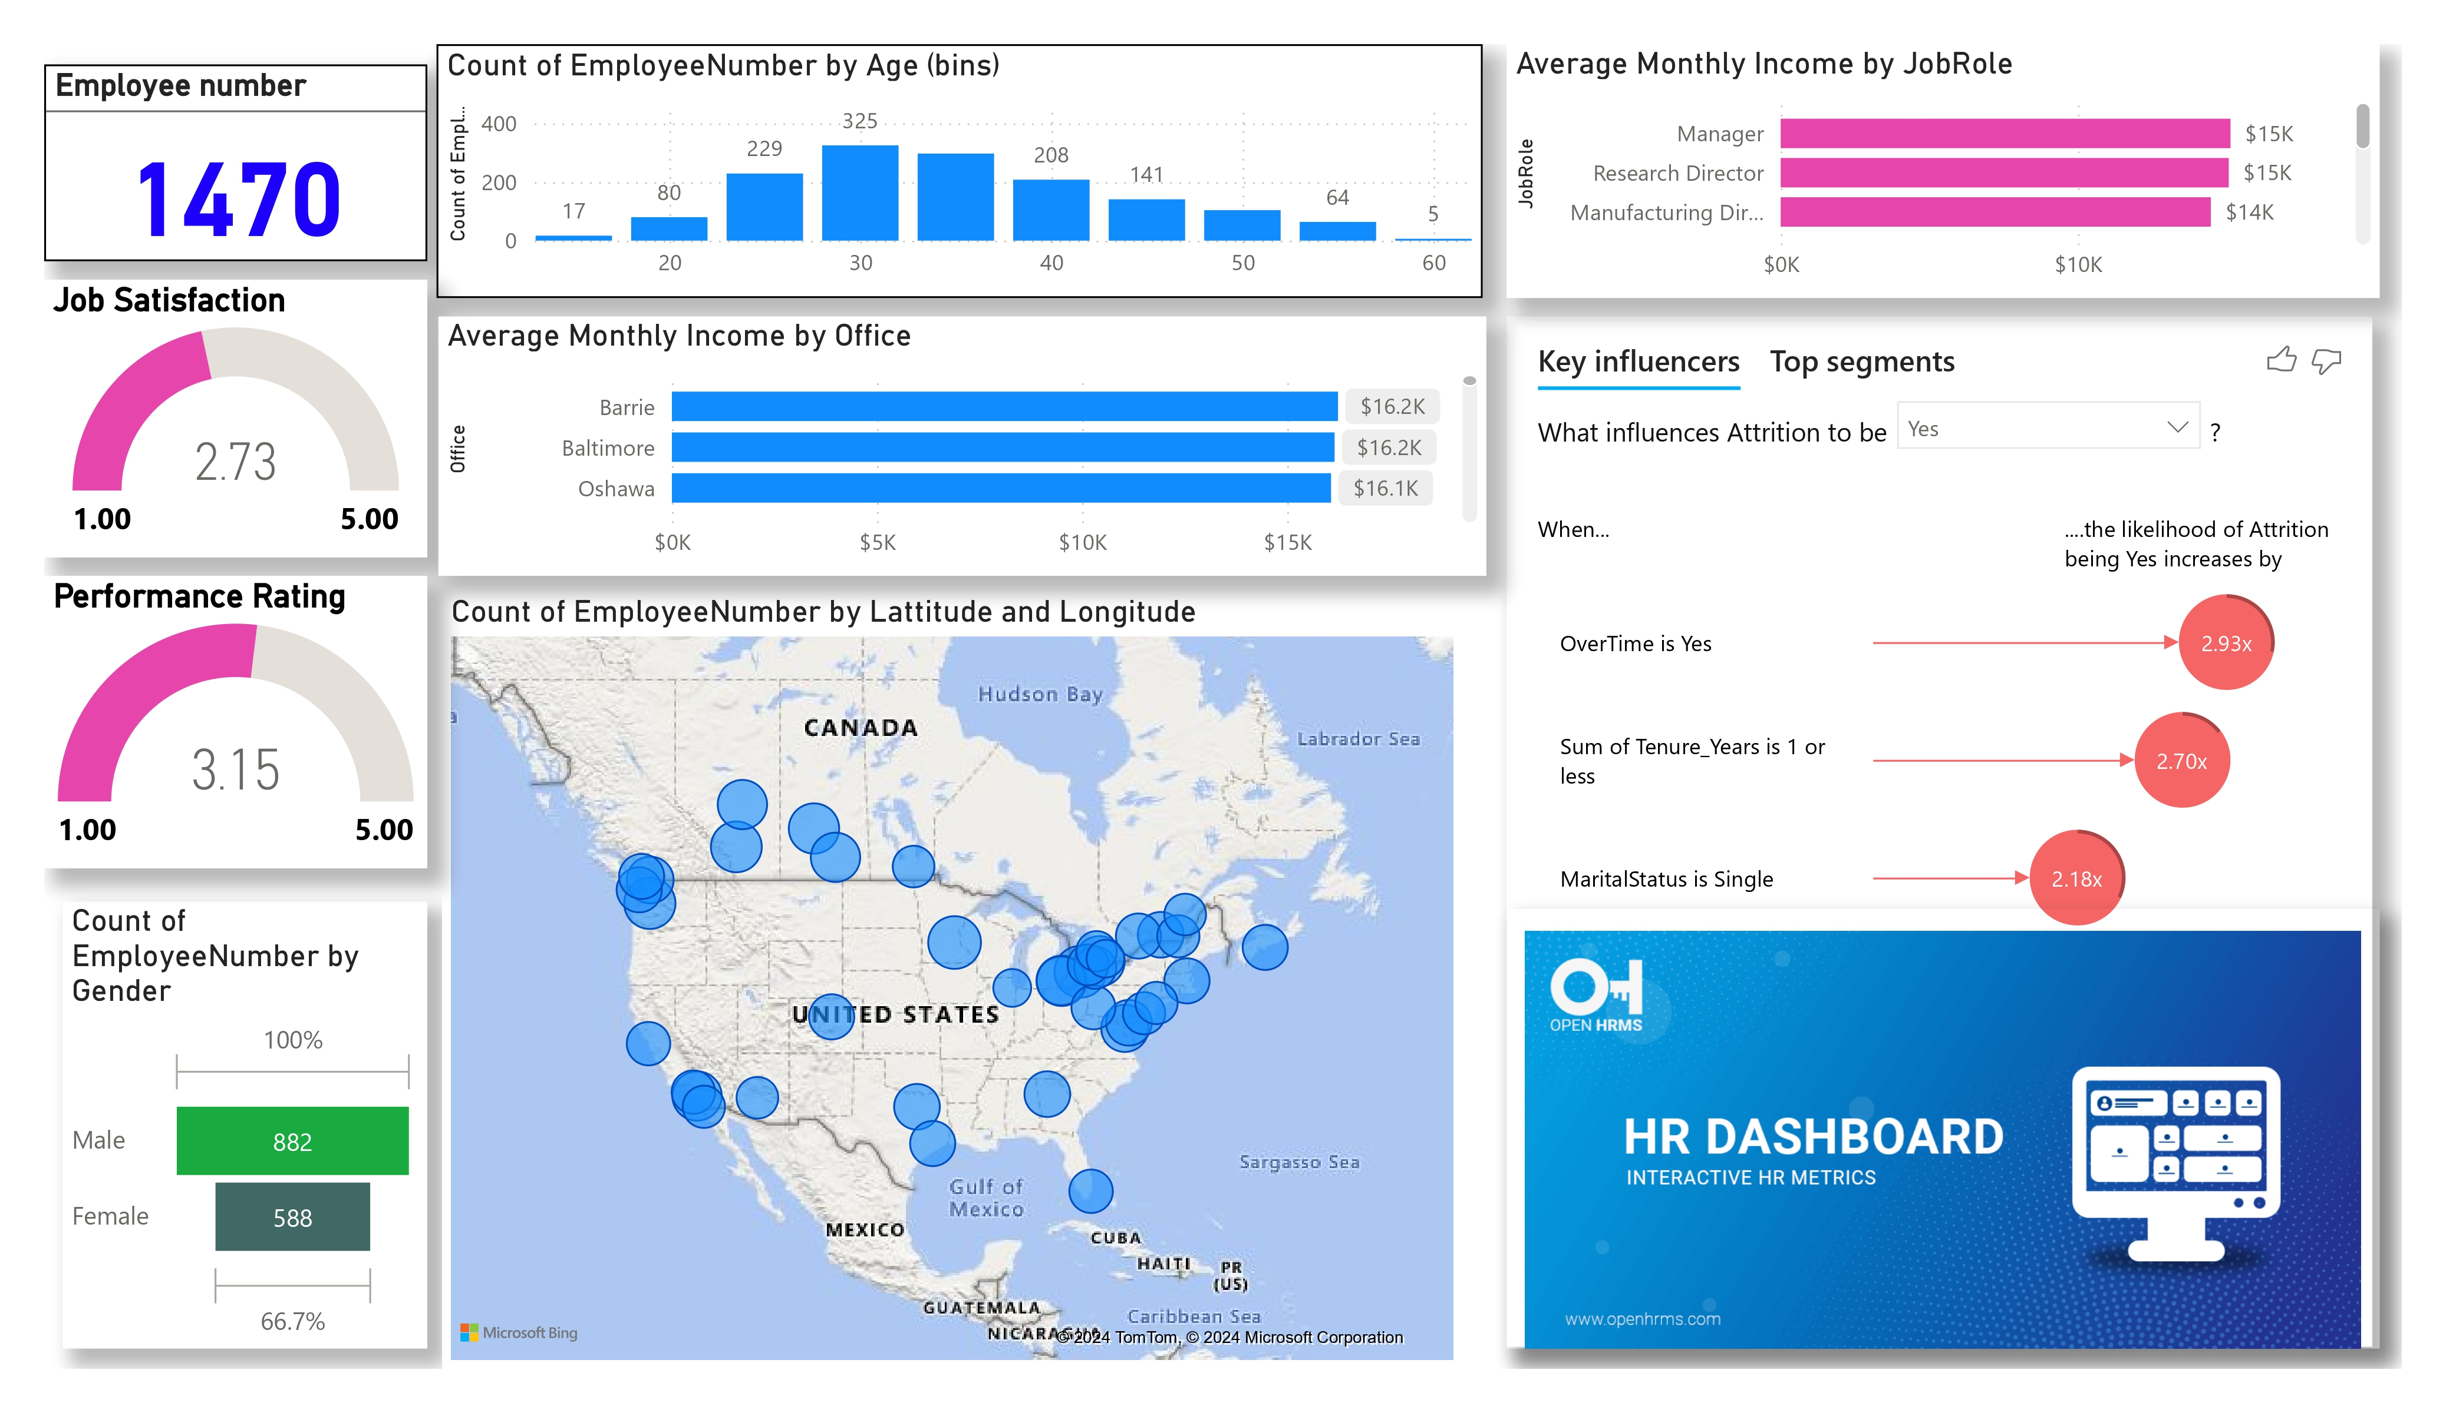

Slide 9
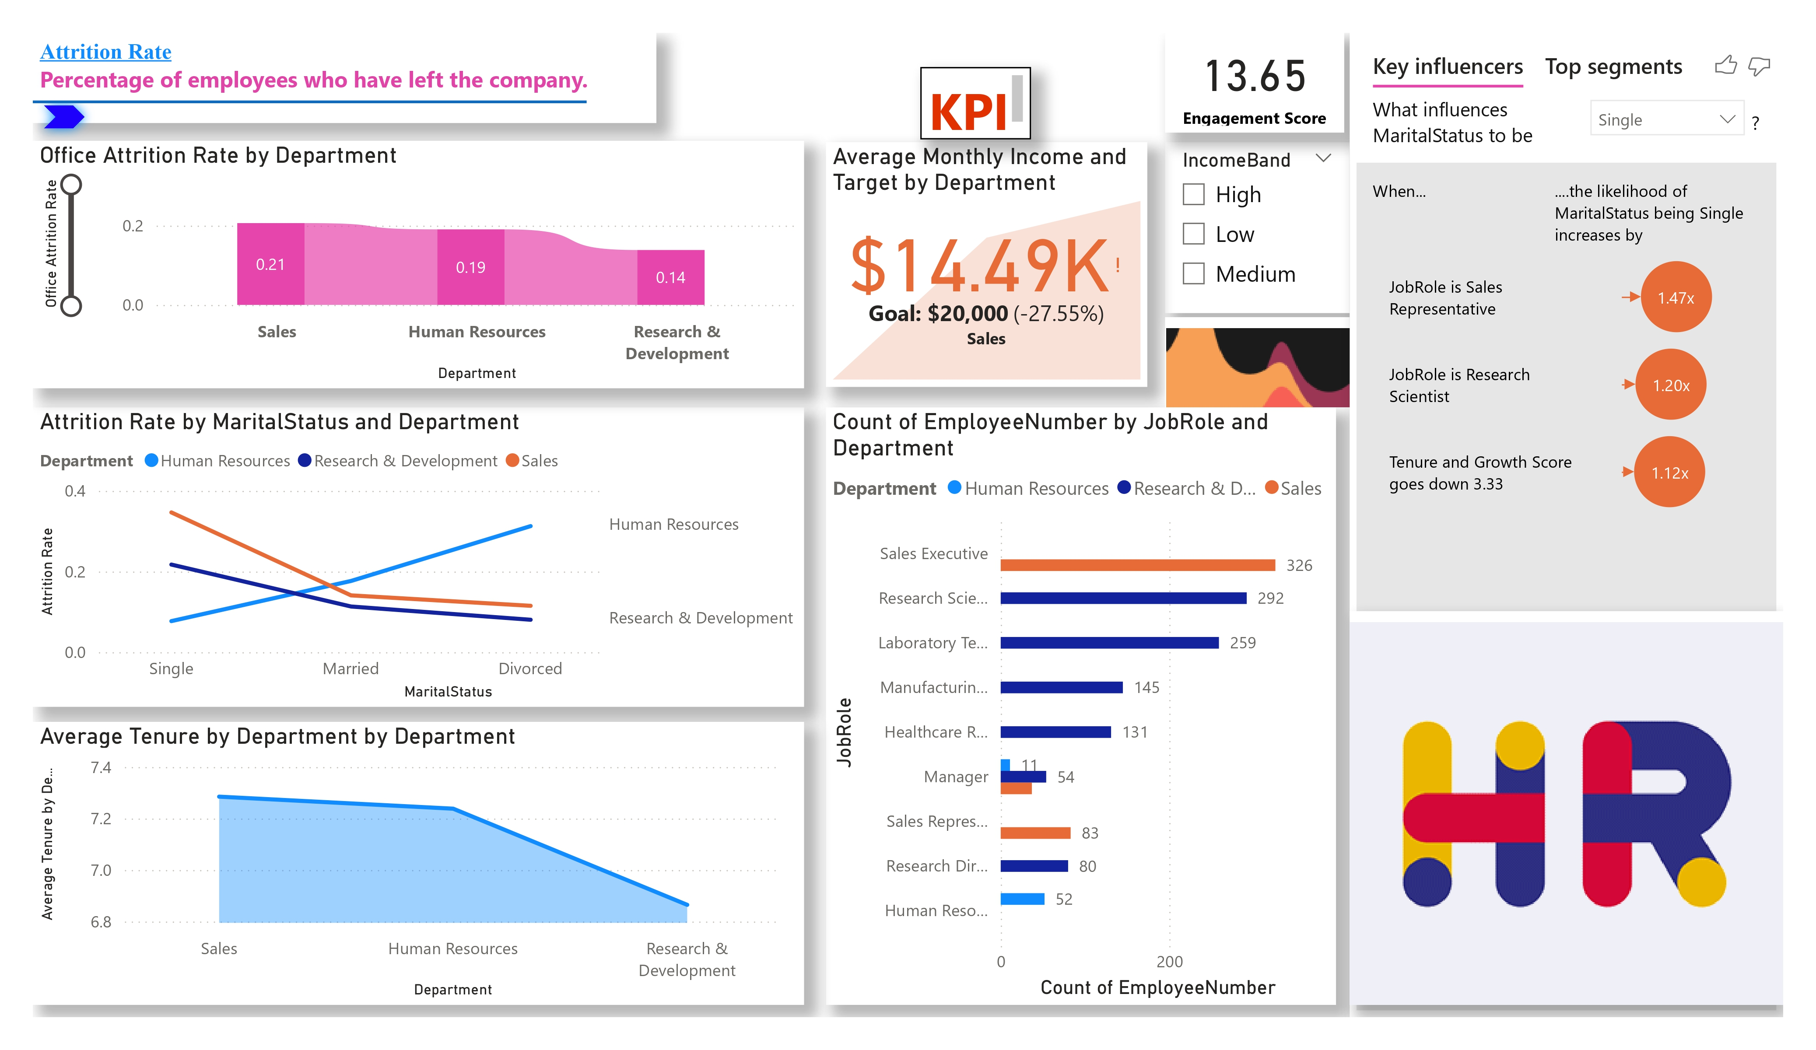

Slide 10
Hands-On Lab

Slide 11

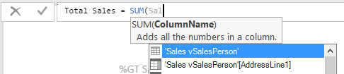
Data Analysis Expressions
DAX is a collection of functions, operators, and constants that can be used in a formula, or expression, to calculate and return one or more values.
Office Attrition Rate =
DIVIDE(
COUNTROWS(FILTER(HRIS, HRIS[Attrition] = "Yes")),
COUNTROWS(HRIS),
0
)
Tenure and Growth Score =
AVERAGEX(
HRIS,
DIVIDE(
[TotalWorkingYears] + [YearsWithCurrManager] +
[YearsSinceLastPromotion] + [YearsInCurrentRole] +
[Tenure_Years] + [PercentSalaryHike],
6
)
)
Data Analysis Expressions, or “DAX” includes a library of over 200 functions, operators, and constructs and are similar to Excel formulas
Notes:
Data Analysis Expressions, or “DAX” includes a library of over 200 functions, operators, and constructs and are similar to Excel formulas. DAX has many of the same functions as Excel, except that DAX functions are meant to work over data interactively “sliced” or filtered in a report. If users are familiar with writing Excel functions, its an easy transition into DAX.

Slide 12
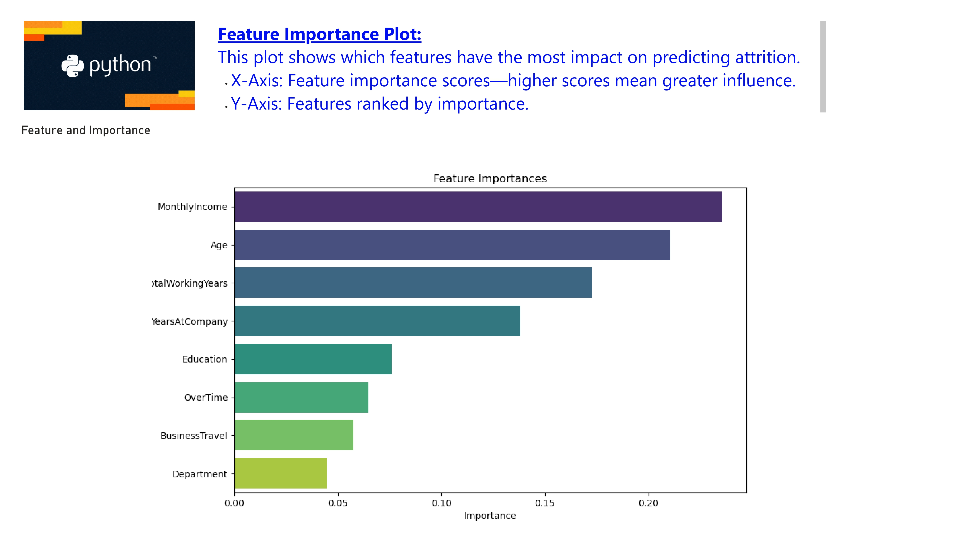
The Feature Importances section identifies the most impactful features used by the Random Forest model to predict attrition.

Slide 13

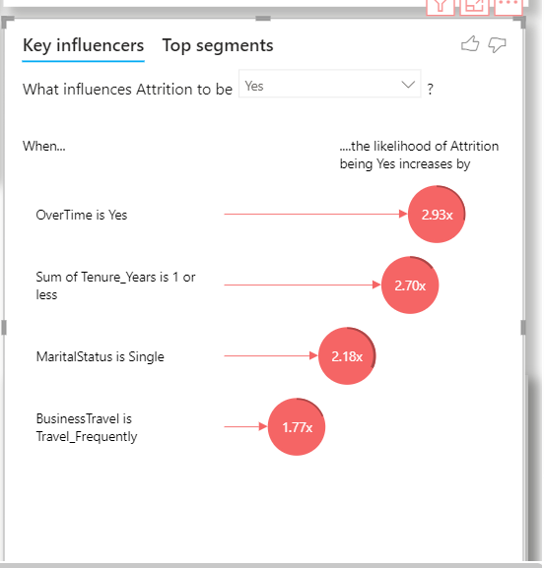
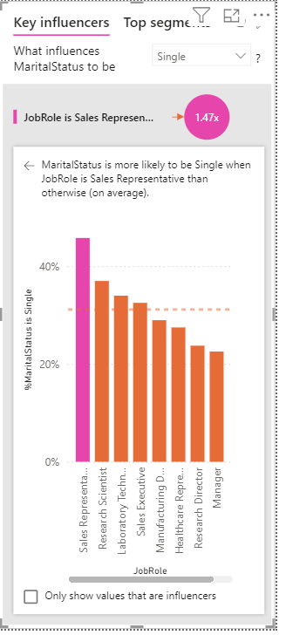
if overtime is less than the people will leave the company almost 3x

Slide 14
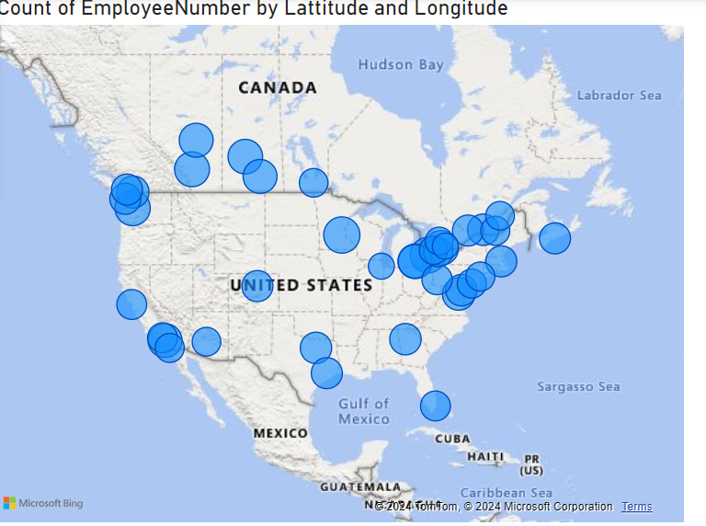
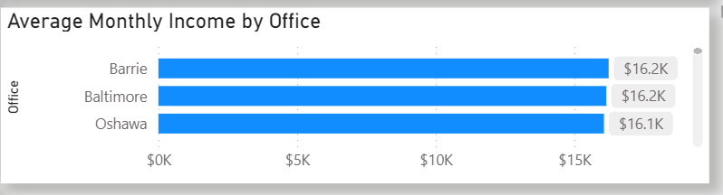
The map is representing that all our employees are from USA and Canada
Highest monthly income is in Barrie and Baltimore office.

Slide 15

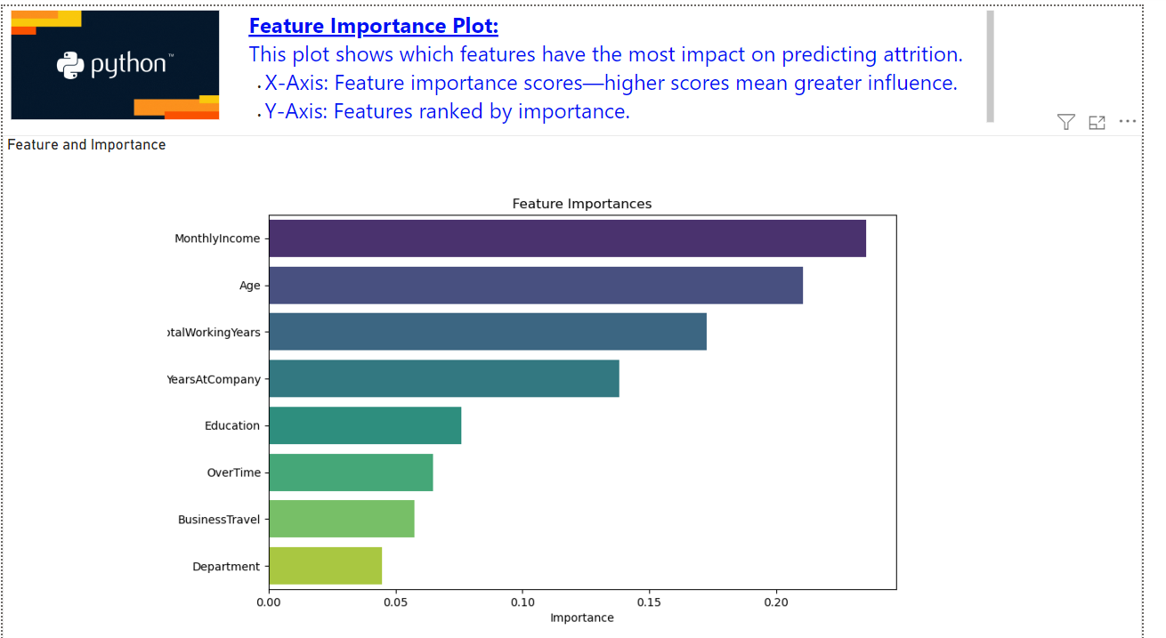


Key Factors Influencing Attrition:
Salary: Higher monthly income is associated with lower attrition rates.
Experience: Longer tenure and more years of experience correlate with lower attrition.
Overtime: Employees working overtime are more likely to leave.
Age: Older employees tend to stay longer.
Less Significant Factors:
Education: Moderate impact on attrition.
Business Travel: Minimal impact on attrition.
Department: Least significant factor.
Note

Slide 16


CONCLUSION FOR HR ANALYSIS
With the help of the Power Bi we can turn the raw into the actionable insights. It will help the HR team to make informed, data-driven decisions. It will helps the HR team to easily understand that what is the reason for attrition rate, Employee’s performace tracking, Recruitement efficiency, Employee’s satisfication etc…
OVERALL SUMMARY OF THE DASHBOARD:
Key Drivers of Employee Attrition: The Feature Importance Plot highlights that Monthly Income, Age, and Total Working Years are the most significant factors influencing employee attrition.
2. Departmental Insights: The Office Attrition Rate by Department reveals that attrition rates are highest in certain departments, with key factors like low monthly income and job dissatisfaction contributing to this trend.
3. Marital Status and Attrition: Single employees are at a higher risk of leaving compared to married or divorced employees, especially in departments with demanding roles like Research and Development.

Slide 17

4. Overtime and Attrition: Employees who frequently work overtime have a 2.93x higher likelihood of leaving, emphasizing the need for better work-life balance initiatives.
5. Geographical Analysis: The Map Visualization identifies clusters of employees by location, which can be used to tailor localized engagement and retention strategies.
6. Job Satisfaction and Tenure: Employees with lower job satisfaction and shorter tenure years are more prone to leaving, as reflected in the average performance ratings and attrition rate by tenure.
7. Actionable Recommendations: Focus on revising compensation packages for critical roles. Implement policies to reduce overtime and enhance work-life balance. Develop engagement programs for single employees and those in high-stress departments. Tailor retention strategies based on location and job role-specific challenges.
“EMPOWERING HR ANALYSIS THROUGH DATA”

